Slide 1





CloudCompare
Presentation
Daniel Girardeau-Montaut
www.cloudcompare.org
@CloudCompareGPL
daniel.girardeau@gmail.com

Slide 2

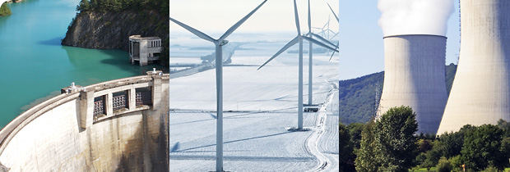
2003: PhD @ EDF R&D
EDF
  More than 150 000 employees worldwide
  2 000 @ R&D (< 2%)
  (200 know about CloudCompare → < 0.2%)
  Revenues > 75 B€
  > 200 dams + 58 nuclear reactors (19 pants)

Slide 3
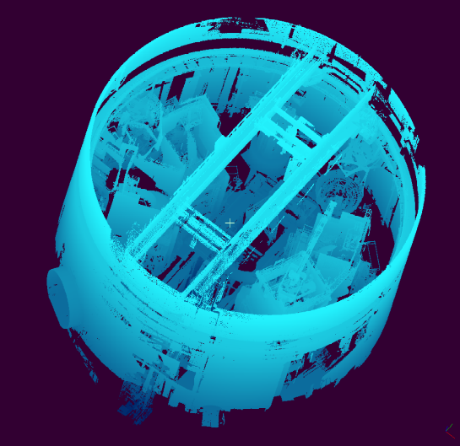
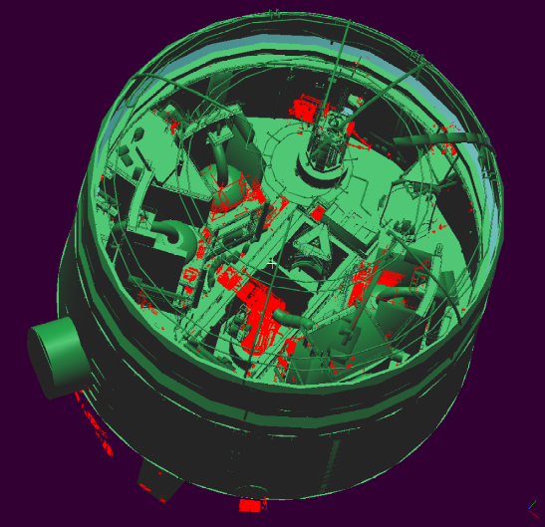
EDF + Laser Scanning
EDF = Mensi (→ now Trimble Laser Scanning)
Main usage: As Built documentation
  Scanning a whole nuclear reactor building
  2002: 3 days, 50 M. points
  2014: 1.5 days, 50 B. points (+ HR pictures)

Slide 4
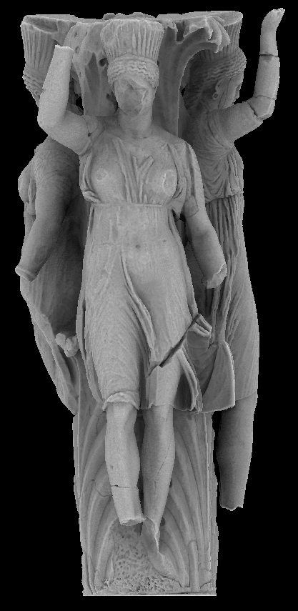
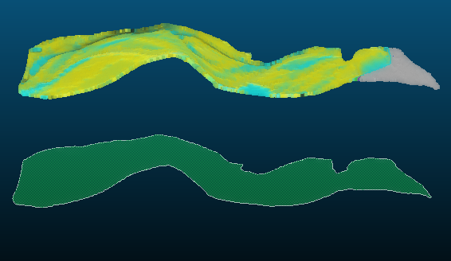
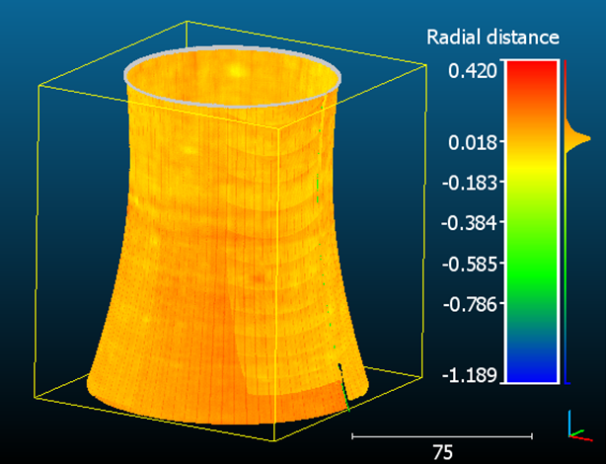
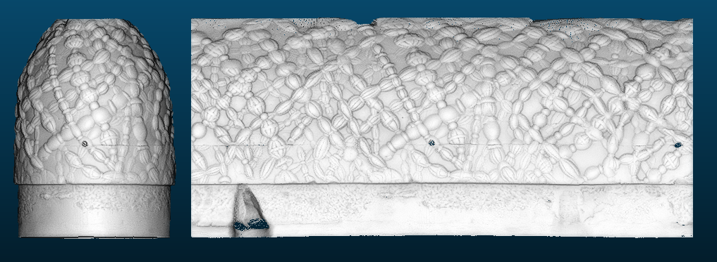
EDF + Laser Scanning
Other applications:
  Building monitoring (dams, cooling towers, etc.)
  Landslide monitoring
  Hydrology
  Cultural Heritage (EDF Foundation)

Slide 5
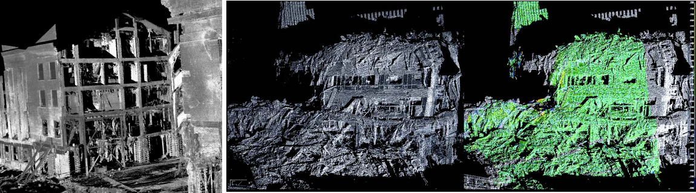
PhD
“Change detection on big 3D geometric data”
  Application to emergency mapping
Inspired from the post 09-11 attacks recovery operations (See. “Mapping Ground Zero”, J. Kern, Optech, Nov. 2001)
→ visualization, crane placement optimization, subsidence monitoring,
collapse risk evaluation, etc.

Slide 6
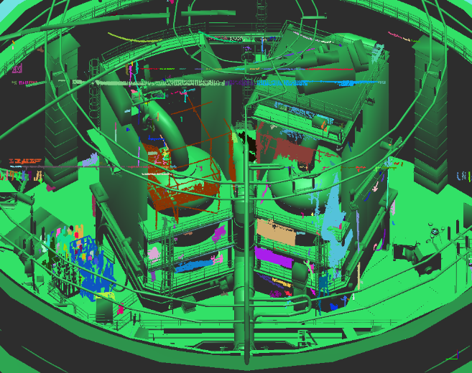
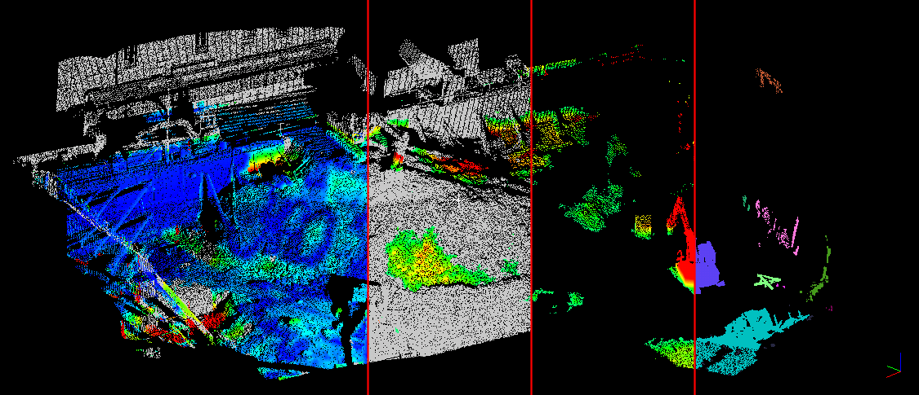
CloudCompare V1
2004-2006
Aim: quickly detecting changes by comparing TLS point clouds…
  with a CAD mesh
  or with another (high density) cloud

Slide 7
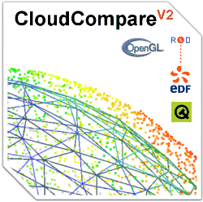
CloudCompare V2
2007: “Industrialization” of CloudCompare … for internal use only (EDF doesn’t sell software!)
2009/2010: Open Source version released (V2.1)
  Already a point cloud edition « swiss knife »
2016: CloudCompare V2.7
Runs on:
  Windows (XP / 7 / 8 / 10)
  Mac OS (Andy Maloney)
  Linux (Romain Janvier)
Support for 3D mouse and NVidia Stereo glasses (Windows only)

Slide 8
Open Source!
Evolves quickly…
… in the direction users want (faster if users actively participate to the developments ☺)
Remains under close supervision of its administrator
Manufacturer independent
Supported by various companies and public institutions
(EDF, BRGM, CNRS, etc.)

Slide 9
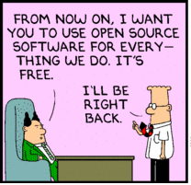
Open Source!
Free…
…however, someone still needs to pay ;)
  either by developping new functionnalities
  or by paying someone else to do it
Plugins are not necessarily open source or free

Slide 10
Users Developers
Too many ;)
  Academics:
    Remote Sensing
    Geology
    Archeology
    etc.
  Surveyors
  Forensic experts
  Architects
  MDs / dentists
  3D designers
  Artists?!
Too few
  a few PhD students and research engineers
  none
  1
  none
  none
  none
  none

Slide 11
SW development cycle
Specs
algorithm
“packaging”
(GUI, details, etc.)
tests
simple forum message
the best part
less funny
developer’s hell
user’s hell
stability
users feedback!
time
First release

Slide 12
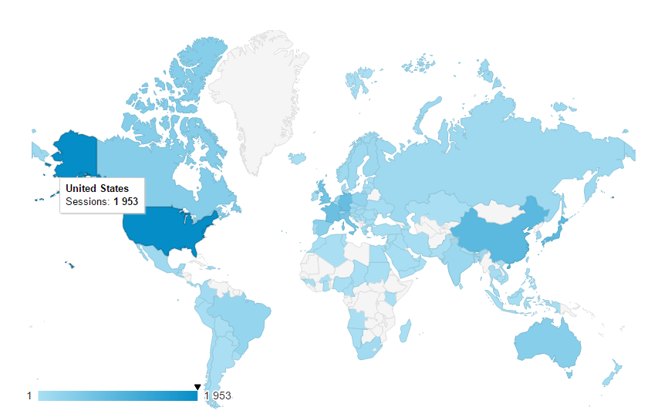
Worldwide users
September
> 2000 registered users to the ‘new release’ newsletter

